Slide 1

Visualization of Flight Delays
And Cancellation
Sagar Hedaoo Khusboo Patel Saurabh Agrawal Dhruvi Patel

Slide 2
Understanding Flight Delays
Flight delays occur when an airline flight takes off or lands later than its scheduled time.
Types of Delays:
Operational Delays: Issues within the airline's control such as maintenance, crew scheduling, or baggage loading.
Technical Delays: Problems related to the aircraft's technical aspects, requiring repair or inspection.
Weather-Related Delays: Inclement weather conditions, including storms, fog, or extreme weather phenomena, that impact flight safety.
Air Traffic Control (ATC) Delays: Delays caused by congestion in the airspace, often managed by air traffic control to ensure safety.
Security and Safety Delays: Security concerns or emergencies that necessitate additional checks or procedures.
Flight delays are a universal issue affecting air travel worldwide, influencing both domestic and international flights.

Slide 3
Importance of Studying Flight Delays
Airlines and airports incur significant costs due to delays and cancellations, including additional operational costs, compensation for passengers, and potential revenue loss.
Understanding delays helps in better allocation of resources like crew, aircraft, and terminal facilities, reducing unnecessary expenses.
Delays and cancellations disrupt travel plans, causing inconvenience, stress, and potential financial loss for passengers.
For flights carrying cargo, delays can disrupt the supply chain, affecting various businesses and industries.
Extended flight times and idling aircraft on the ground increase fuel consumption and carbon emissions.
Understanding the patterns and causes of delays can help in ensuring that safety is not compromised in efforts to minimize delay times.

Slide 4
Problem Statement
What are the main causes for flight delays and cancellations?
% of flights delayed
Top 10 airlines with the most delays/cancellations
Top 10 delayed/cancelled flights by origin
Top 10 delayed/cancelled flights by destination
Highest % cause of delays/cancellations
Carrier
Weather
NAS Delay
Security
Late Aircraft

Slide 5
About the Dataset
The dataset contains all flight information including cancellation and delays by airline in 2022.
The dataset has more than 25000 + records.
We are using Python programming language and its important libraries – NumPy, Pandas and Matplotlib for the purpose of the project

Slide 6
About the Libraries
NumPy
NumPy provides support for large, multi-dimensional arrays and matrices, along with a collection of mathematical functions to operate on these arrays. Its efficiency in numerical computations makes it ideal for handling large datasets.
Matplotlib
Matplotlib offers a wide array of plot types, from basic line and bar charts to complex histograms and scatter plots, making it versatile for visualizing various aspects of flight delay data.
Pandas
Pandas simplifies tasks like data loading, cleaning, and transformation. Its DataFrame structure is intuitive and flexible, making it ideal for manipulating and analyzing flight data.

Slide 7
Data Description
The data has been extracted from the Marketing Carrier On-Time Performance (Beginning January 2022) data table of the "On-Time" database from the TranStats data library.
We used a combination of 7 different CSV files to make our final dataset which contained over 4 million rows of data!
We narrowed the columns down from 160 to 10 columns that were relevant to our data needs using the following tools:
Random Forest
MatplotLib
Tableau
Dask Library
Pandas

Slide 8
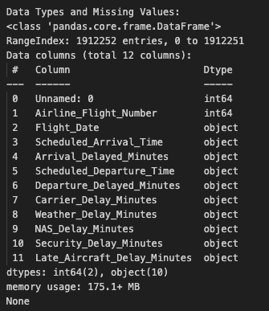
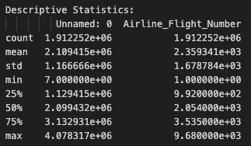
Exploratory Data Analysis
We are using Python’s Pandas library to draw useful insights out of the data.
The entire dataset consumes 175.1+ MB of memory.
The names of different columns can be seen in Fig 1.

Slide 9
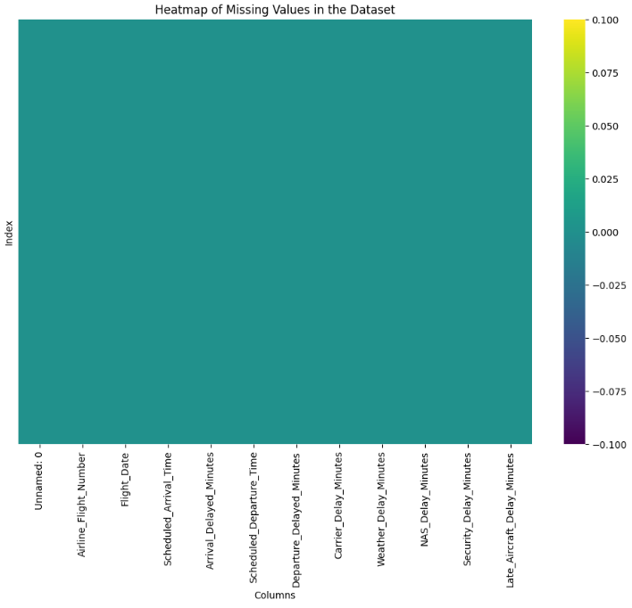
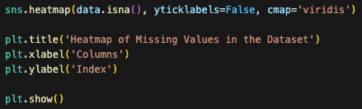
Checking for Null values
We have created a Heatmap to depict the presence of Null values in the columns of the dataset.
On looking at the Heatmap we can see that there is no Null value in any of the columns in the dataset.

Slide 10
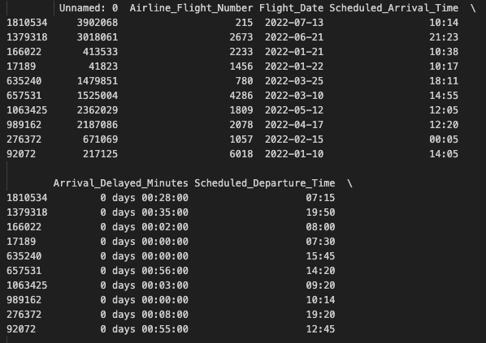
Descriptive statistics for Numerical Columns

Slide 11
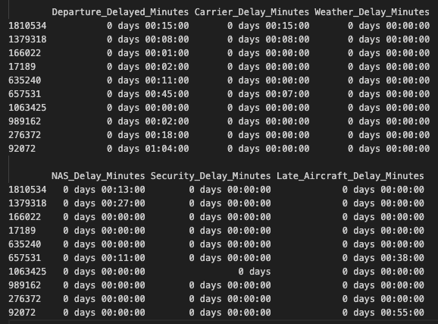
Descriptive statistics for Numerical Columns (Cont.)

Slide 12
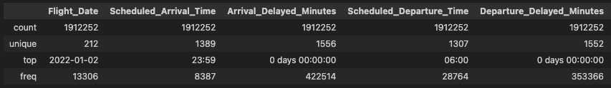
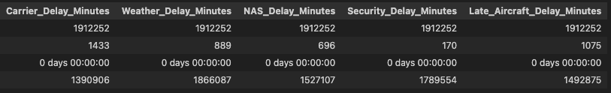
Descriptive statistics for Categorical Columns

Slide 13
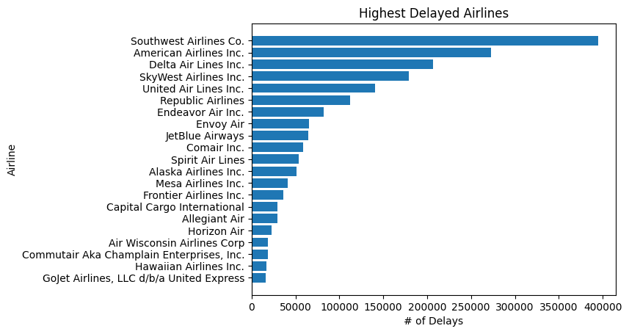
Highest Delayed Airlines

Slide 14
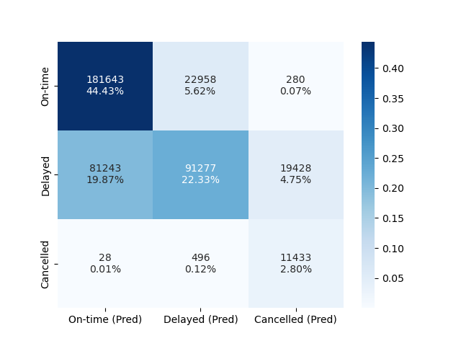
Confusion Matrix for Balanced Random Forest Model
Model Accuracy: 77.4%
Precision Values:
On-time: 69%
Delayed: 80%
Cancelled: 37%
Recall Values:
On-time: 89%
Delayed: 47%
Cancelled: 95%

Slide 15
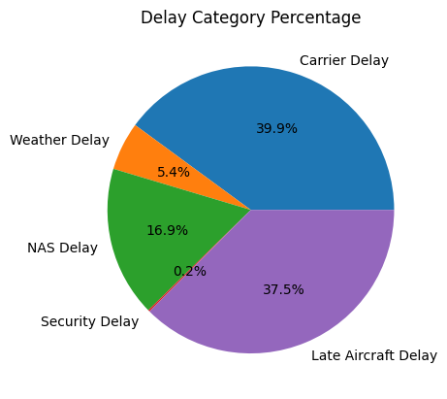
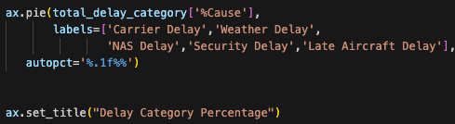
Delay Category Percent
Highest Delay Category: Carrier Delay
Lowest Delay category: Security Delay

Slide 16
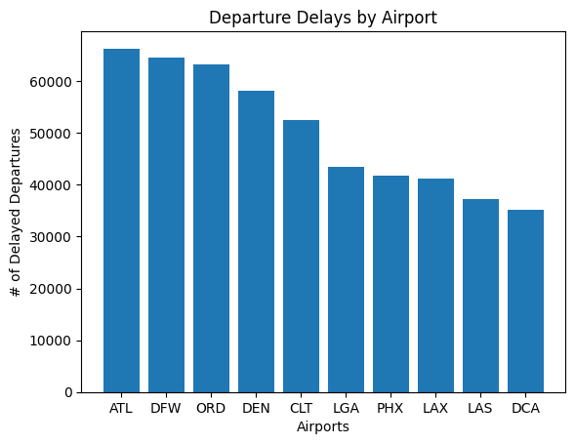
Departure Delays by Airport

Slide 17
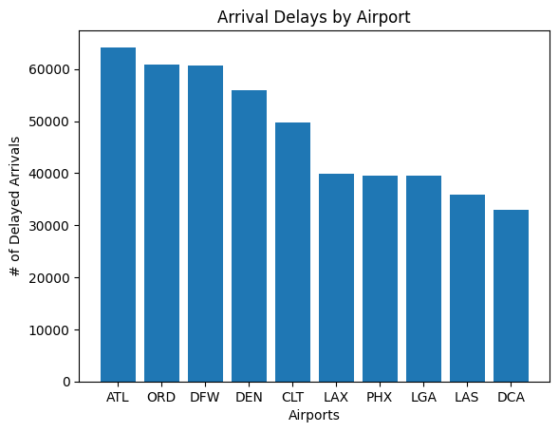
Arrival Delays by Airport

Slide 18
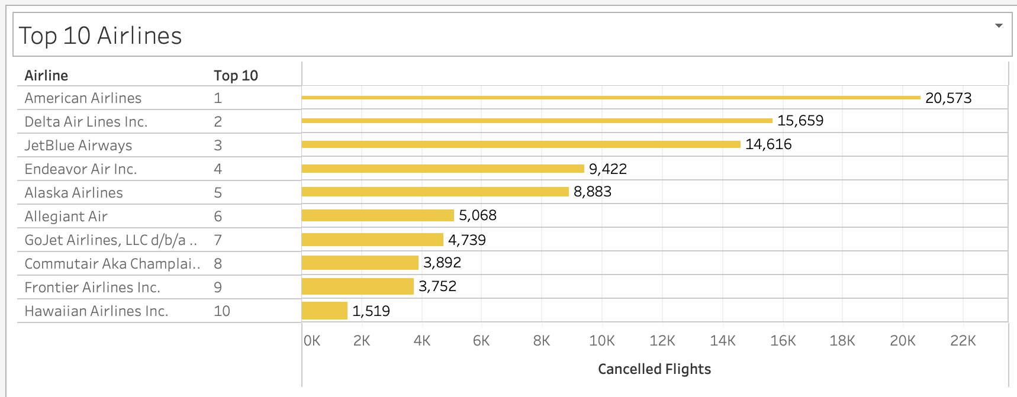
Top Cancelled Airlines

